Slide 1
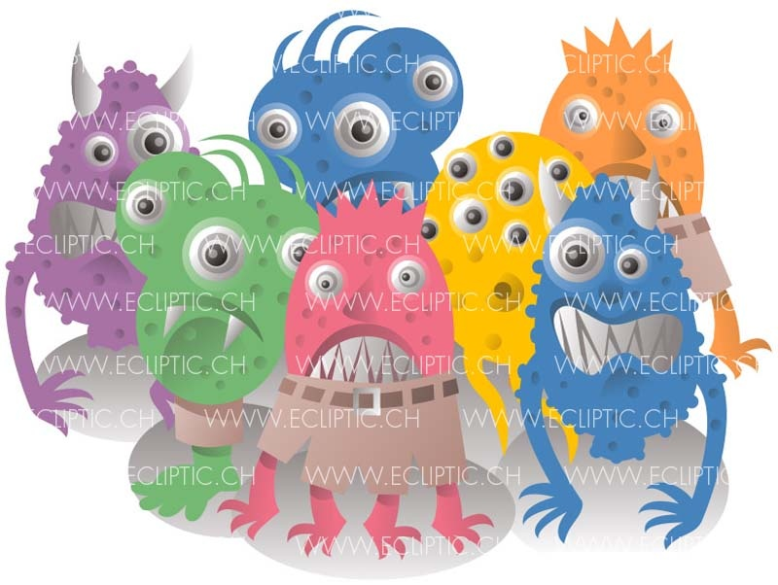
Computer Viruses

Slide 2
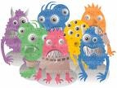
Computer Viruses
  A computer virus is an application program designed and written to destroy other programs.
  It has the ability to:
    Link itself to other programs
    Copy itself (it looks as if it repeats itself)

Slide 3
Examples of Viruses
  Monkes
  ABC
  Crabs
  CIH

Slide 4
Viruses and Virus Protection
A virus program
  Infects programs, documents, databases and more …
  It is man-made
  It can hide and reproduce
  It can lay dormant (inactive) and then activate
  Anti-virus programs can help

Slide 5
Viruses and Virus Protection (2)
A variety of highly contagious “viruses” can spread from computer to computer, much the way biological viruses do among human beings.
  Just as a virus can infect human organs, a computer virus can infect programs and databases. It can also hide duplicates of itself within legitimate programs.

Slide 6
Viruses and Virus Protection(3)
These viruses, which are programs, reside on and are passed between magnetic disks.
Most people who write and circulate virus programs fall into two groups.
  The first group uses viruses to show off for their peers.
  The second, and far more dangerous group, creates viruses with malicious intent.

Slide 7
Sources of Computer Viruses
Three primary sources
  The Internet
    Via downloads and exchanges
  Diskettes
    Exchanging disks
  Computer networks
    Can spread from one network to another

Slide 8
How do you know if you have a virus?
Lack of storage capability
Decrease in the speed of executing programs
Unexpected error messages
Halting the system

Slide 9
Virus Protection
The software package distributed with new PCs always includes an antiviral program. The best way to cope with viruses is to recognize their existence and use an antiviral, or antivirus program.

Slide 10
Some tips that will help minimize your vulnerability to viruses:
Delete e-mails from unknown or suspicious, untrustworthy (unreliable) sources, especially those with files attached to an e-mail.
Never open a file attached to an e-mail unless you know what it is, even if it appears to come from a friend.
Download files from the Internet only from legitimate and reputable sources.
Update your antivirus software at least every two weeks as over 200 viruses are discovered each month.
Backup your files periodically
Traditionally virus protection has been at the PC or client level. However, this may change as companies look to network and Internet service providers for more services.

Slide 11
Computer Ethics
You shall not use a computer to harm other people.
You shall not snoop around in other people's computer files.
You shall not use a computer to steal.
You shall not use other people's computer resources without authorization or proper compensation.
You shall always use a computer in ways that show consideration and respect for your fellow humans.

Slide 12
Computer Uses
1- Supermarkets: Use a bar code reader.
2- Libraries: Use computers to search for books; to record books
lending and return ….
3- Banks: Enable customers to access their accounts via ATM.
4- Plastic Cards: Used in computer system to facilitate customers
life (mobile, telephone and credit cards)
5- Electronic Commerce: Uses Internet in business for
purchasing, payment, or reservations.
6- Touch Screens: Allow unskilled customers to access
information easily.
7- Hospitals: Use computers to store records of patients and to
help in the diagnosis and analysis of the treatment.
8- Cars: Computers are used to display maps and give
instructions to the driver.

